Slide 1
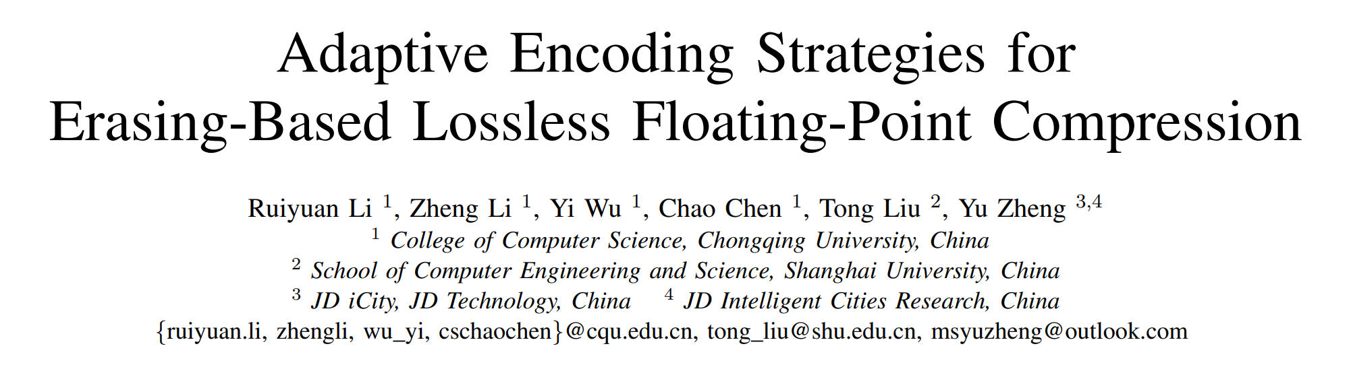
Yi Xu, Chongqing University
2023, 9

Slide 2

Background
Explosion of Floating-Point Time Series Data in a Streaming Fashion
0.5TB data/flight
Lossless Time Series Compression Plays a Fundamental Role in a Wide Range of Critical Scenarios
The Complexity of Underlying Structure of Floating-point Values in Time Series

Slide 3
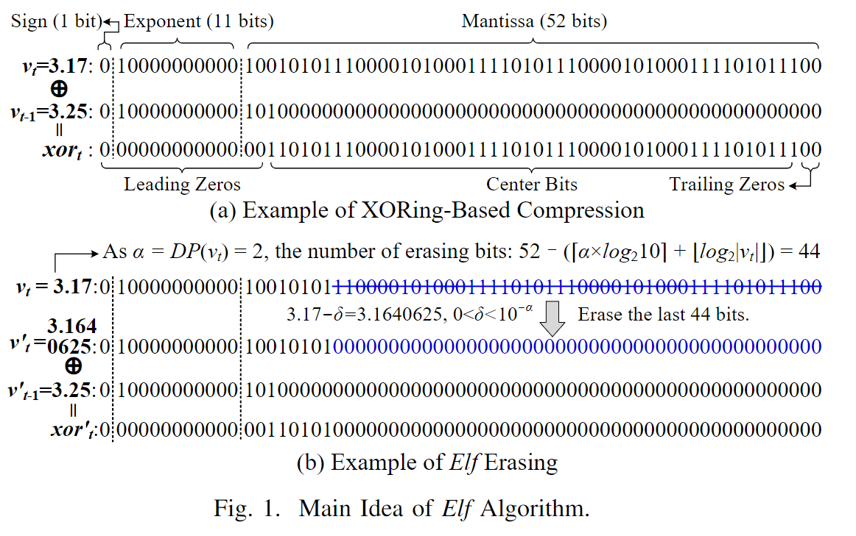
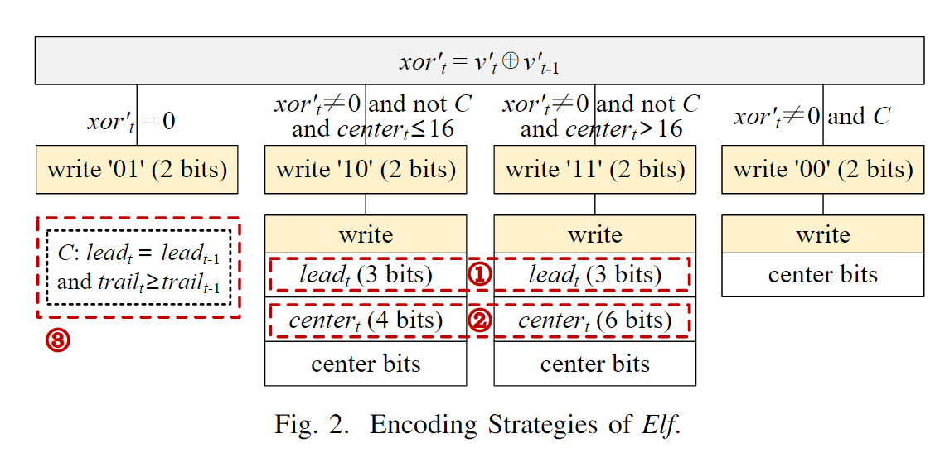
Background
C is "lead_{t} =lead_{t}−1 and trail_{t} ≥ trail_{t}−1"
The encoding strategies of Elf still leave much room for improvement.

Slide 4
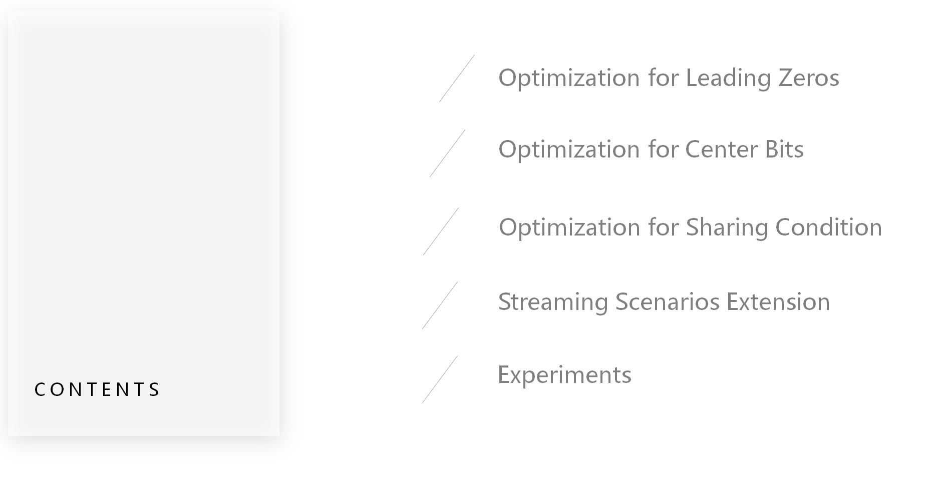

Slide 5
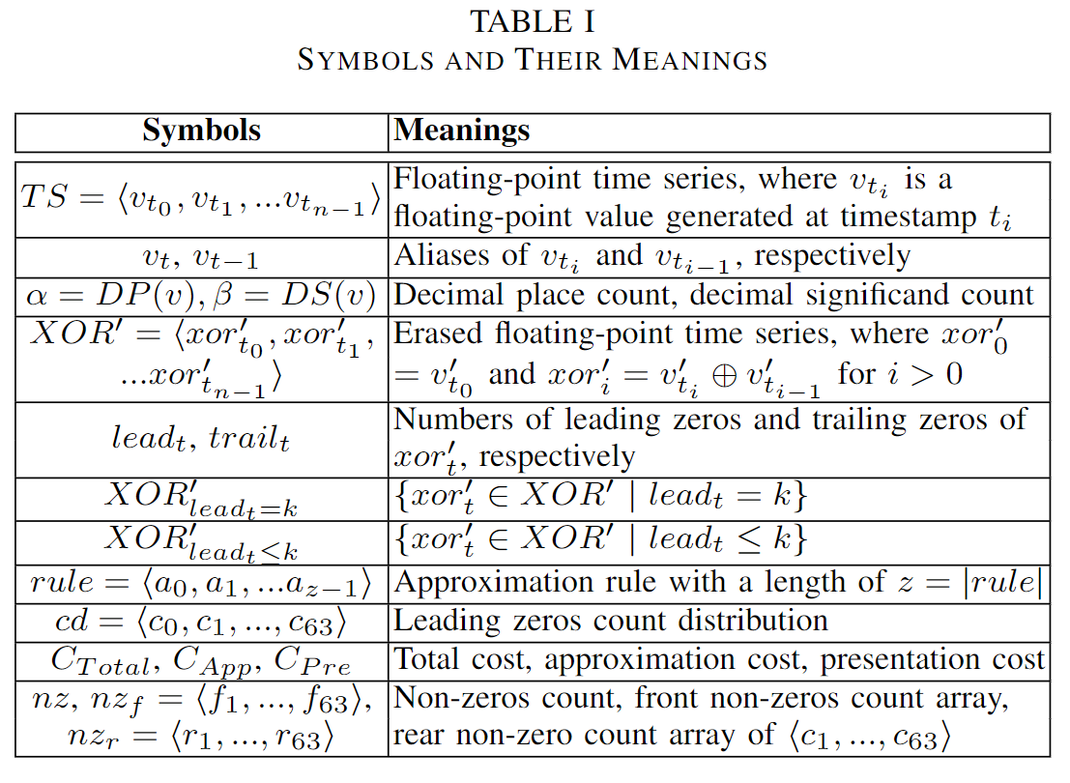
Preliminaries

Slide 6
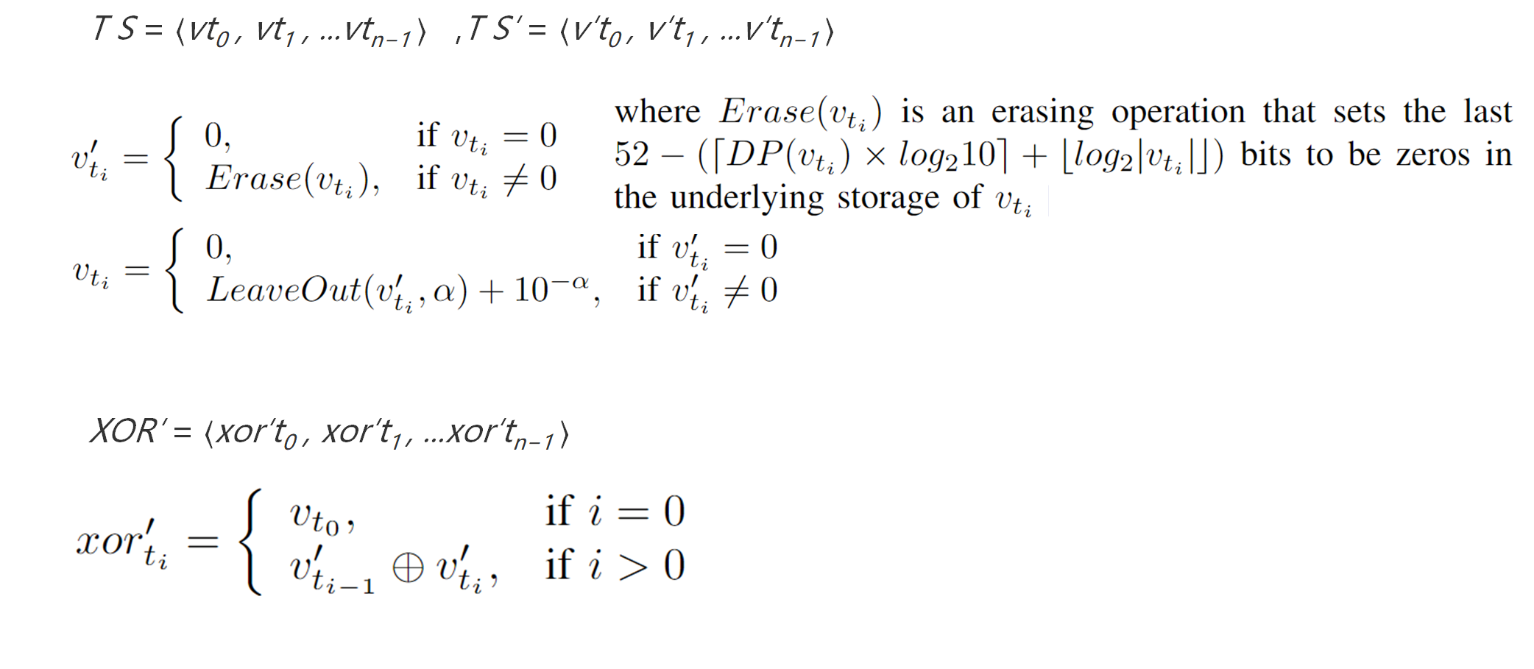
Preliminaries

Slide 7
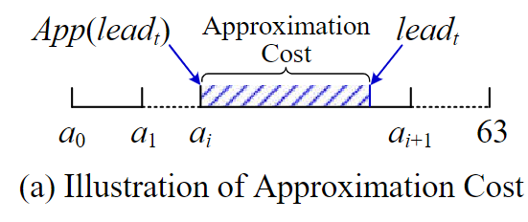
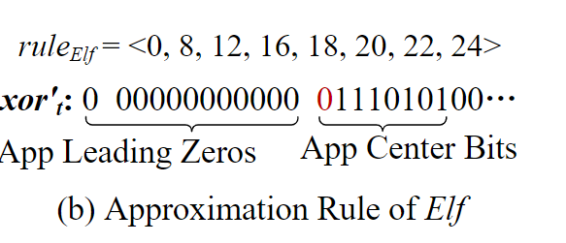
Optimization for Leading Zeros Existing Solutions for Encoding Leading Zeros
Approximation Rule, Approximation Cost and Presentation Cost

Slide 8
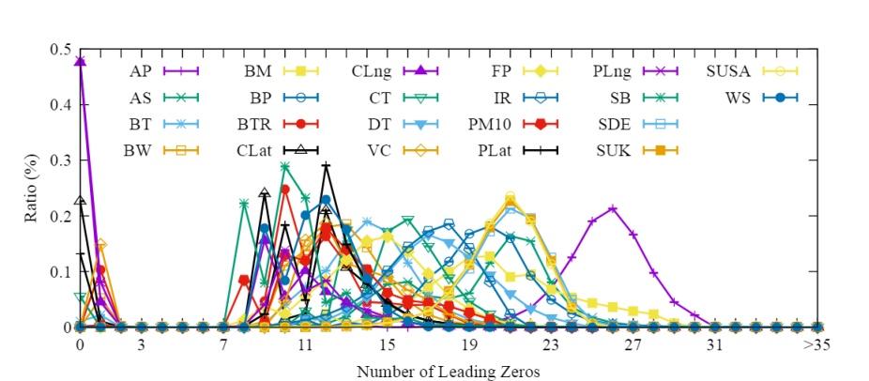
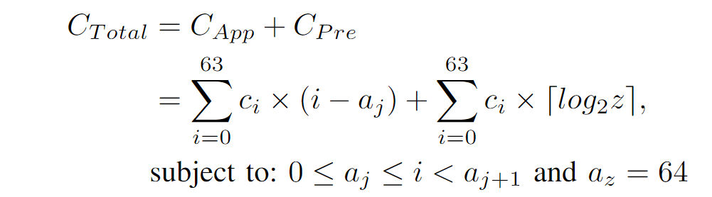
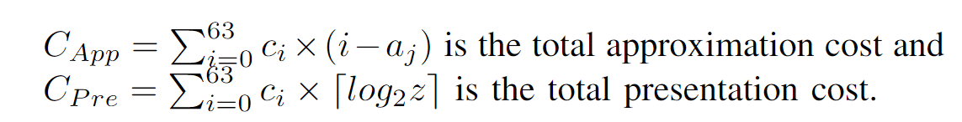
Optimization for Leading Zeros Existing Solutions for Encoding Leading Zeros
Total cost
XOR′ = ⟨xor′t₀ , xor′t₁ , ...xor′t_{n−1} ⟩ its leading zeros count distribution cd = ⟨c₀, c₁, ..., c₆₃⟩
the total cost of rule = ⟨a₀, a₁, ..., a_{z−1}⟩

Slide 9
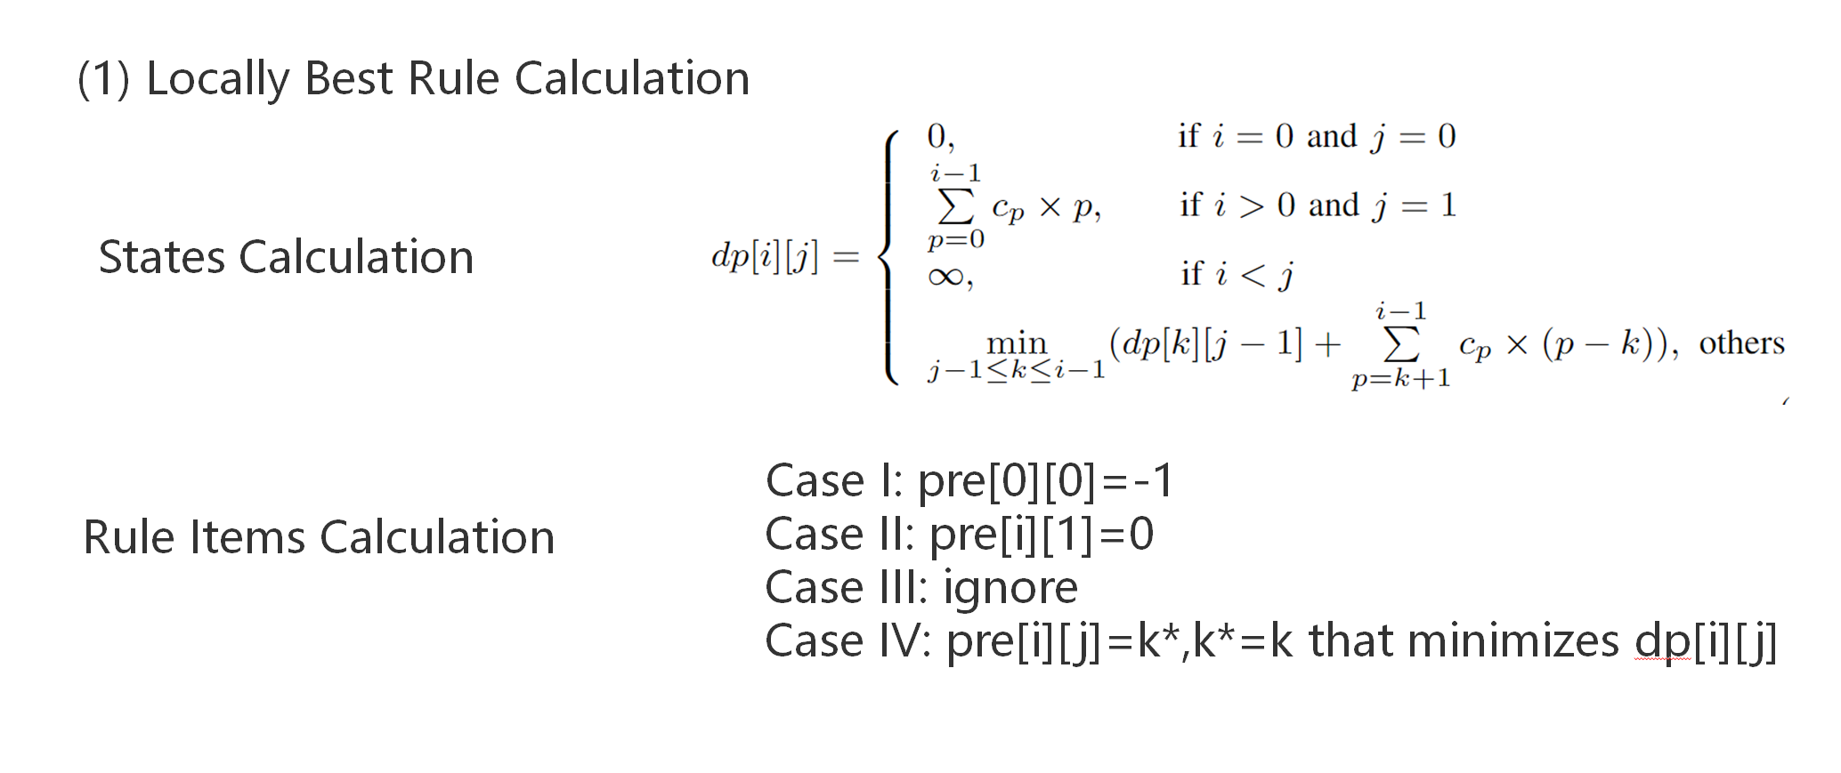
Optimization for Leading Zeros Adaptive Leading Zeros Encoding Strategy

Slide 10
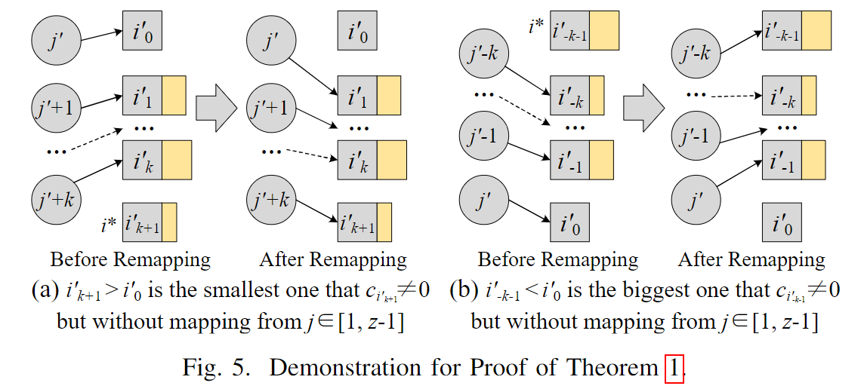
Optimization for Leading Zeros Adaptive Leading Zeros Encoding Strategy
Pruning Strategies

Slide 11
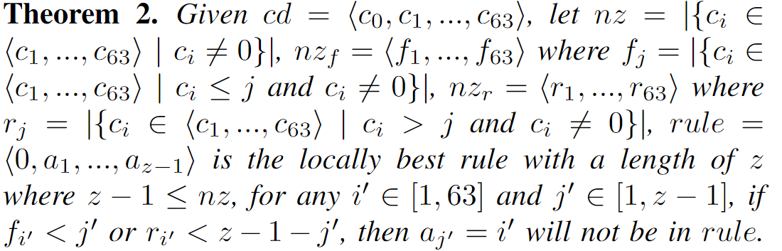
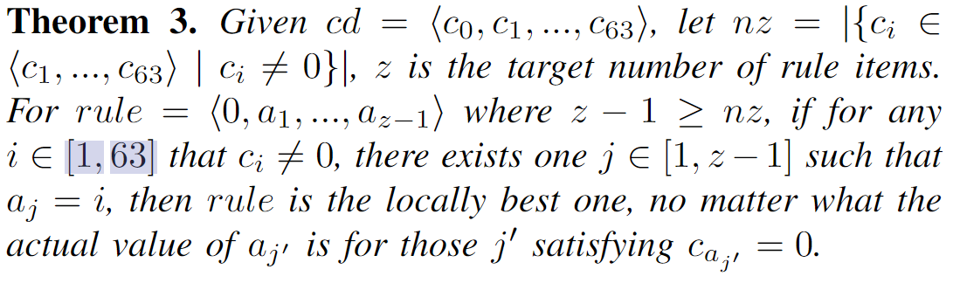

Slide 12
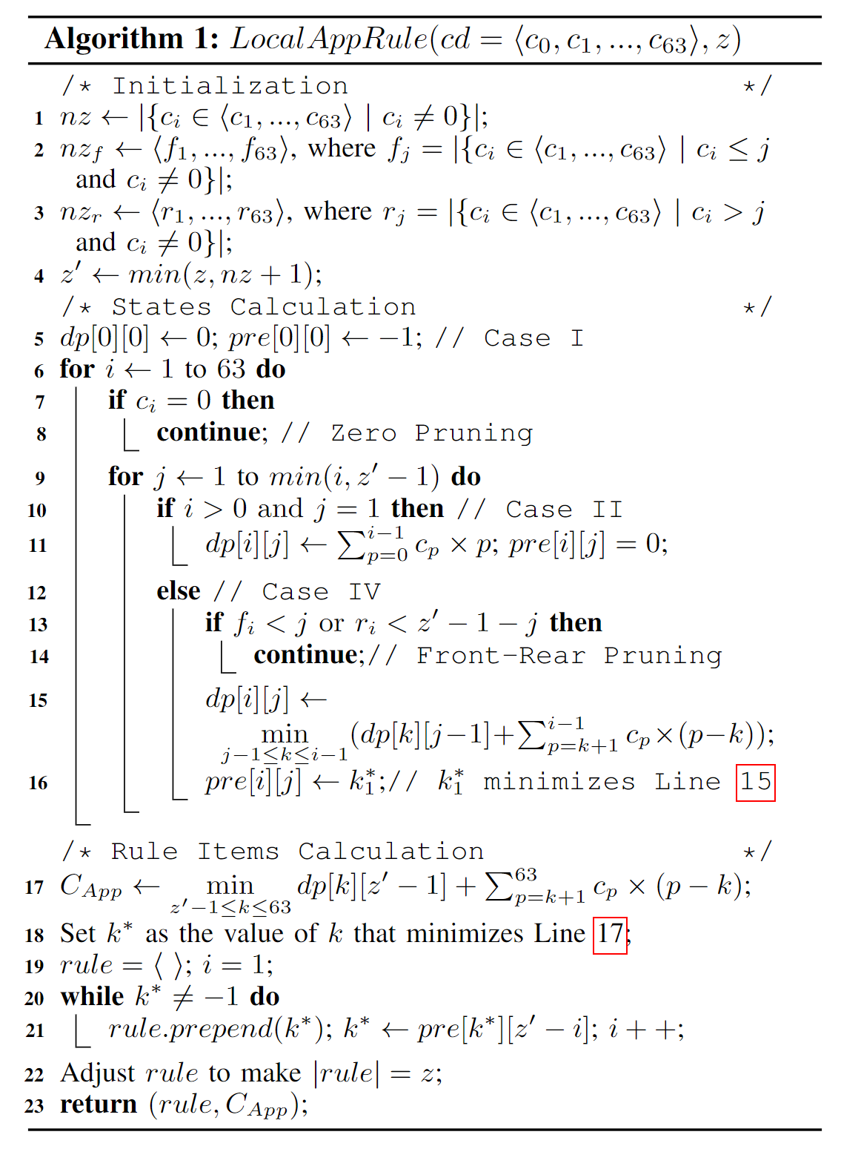
Optimization for Leading Zeros Adaptive Leading Zeros Encoding Strategy
(1) Locally Best Rule Calculation
Locally Best Rule Algorithm
O(nz × min(z, nz + 1) × nz × 64) ≈ O(64 × nz³)

Slide 13
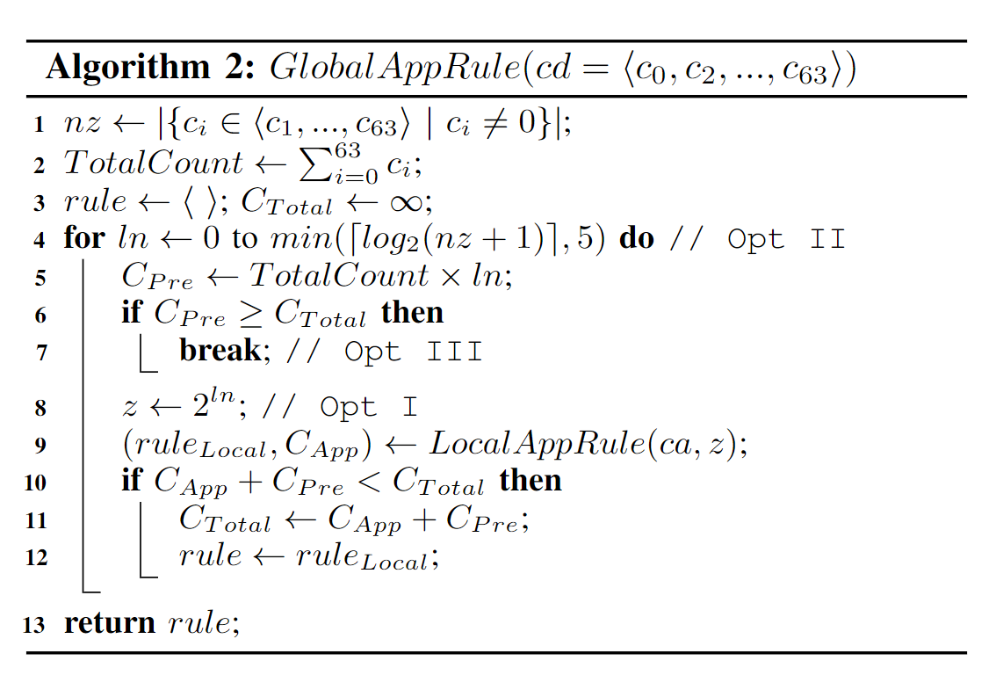
Optimization for Leading Zeros Adaptive Leading Zeros Encoding Strategy
(2) Globally Best Rule Calculation
Opt I: Exponential Values Only
Opt II: Skipping Some Exponential Values.
Opt III: Presentation Cost Pruning.
O(64 × nz³ × 6)

Slide 14
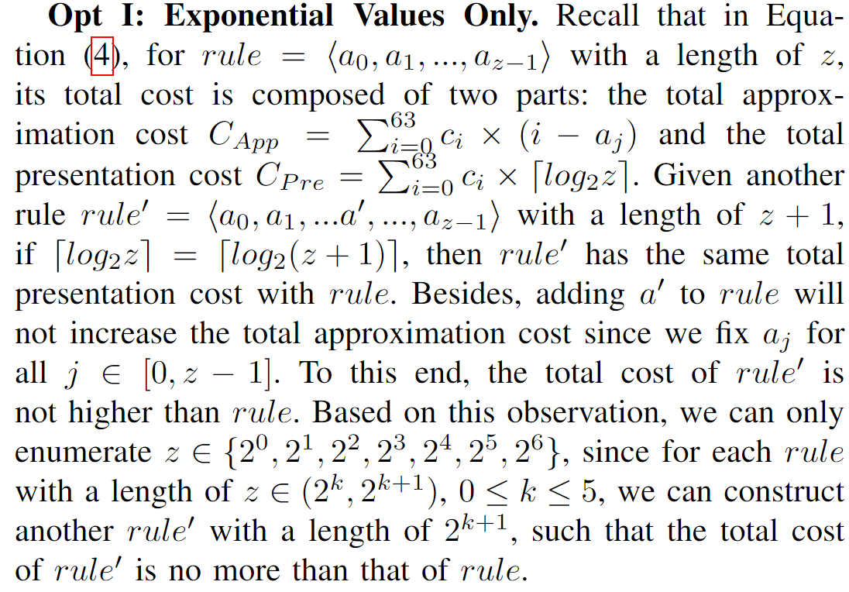
Optimization for Leading Zeros Adaptive Leading Zeros Encoding Strategy
(1) Globally Best Rule Calculation

Slide 15
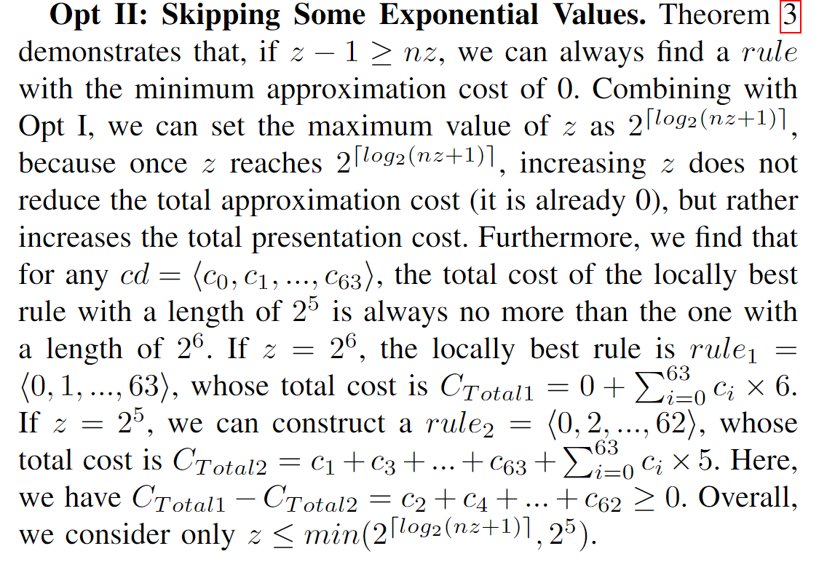
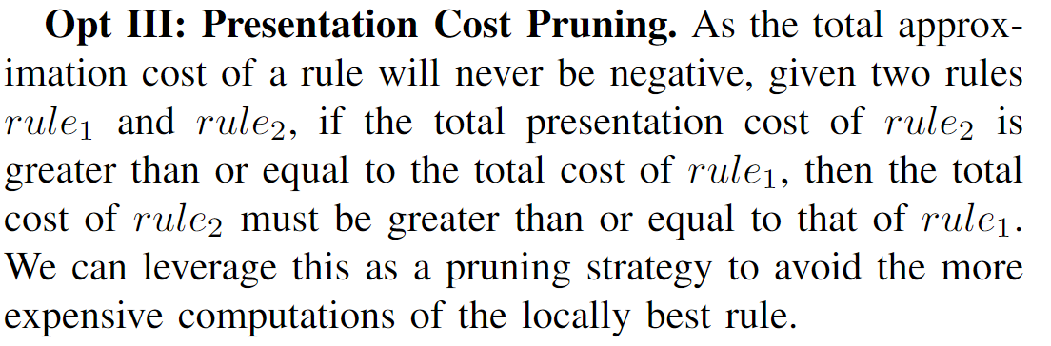
Optimization for Leading Zeros Adaptive Leading Zeros Encoding Strategy
(1) Globally Best Rule Calculation

Slide 16
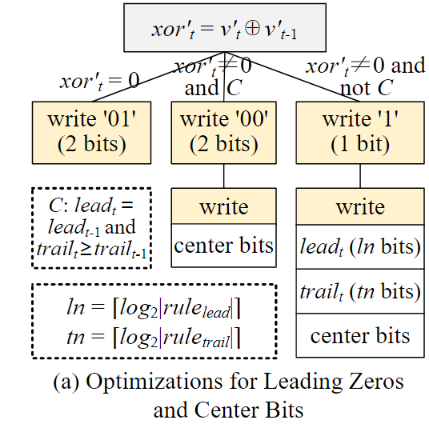
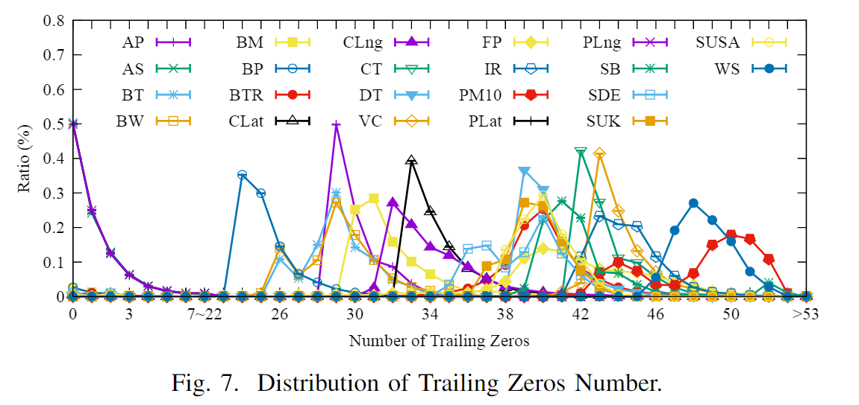
Optimization for Center Bits
Shortcomings:
In case that Elf can only erase a small number of last few bits, it results in a large number of center bits, so it always requires 6 bits to encode center_{t}.
As it requires for an extra bit to distinguish between the two cases (i.e., " center_{t} ≤ 16" and " center_{t} > 16"), it occupies as many as 5 or 7 bits to encode center_{t}.
center_{t} = 64 − lead_{t} − trail_{t}

Slide 17
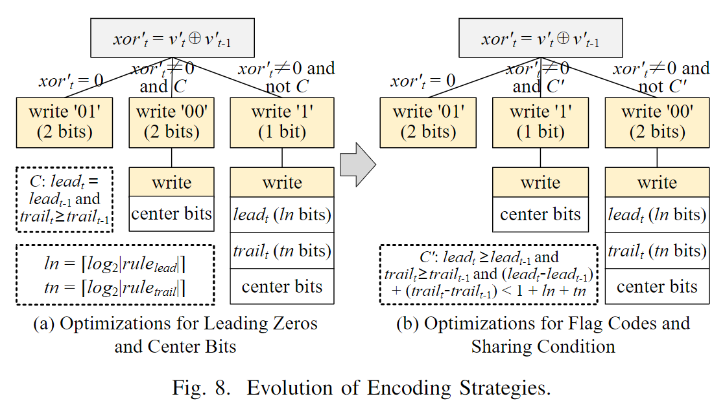
Optimization for Sharing Condition
Flag Codes Reassignment & Sharing Condition Adaptation
Shortcomings:
The selection of flag codes might be suboptimal, because it ignores the frequency of each case.
Since we utilize the adaptive bits for lead_{t} and trail_{t}, the condition C adopted by Elf may be not suitable for our scenarios.

Slide 18
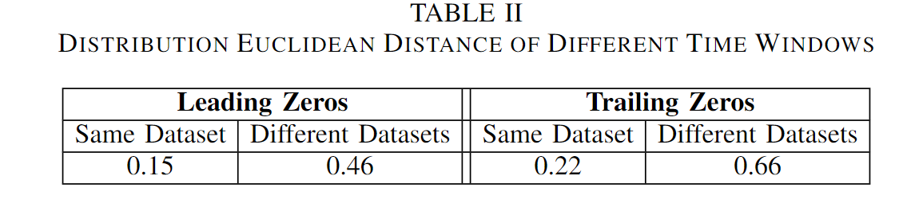
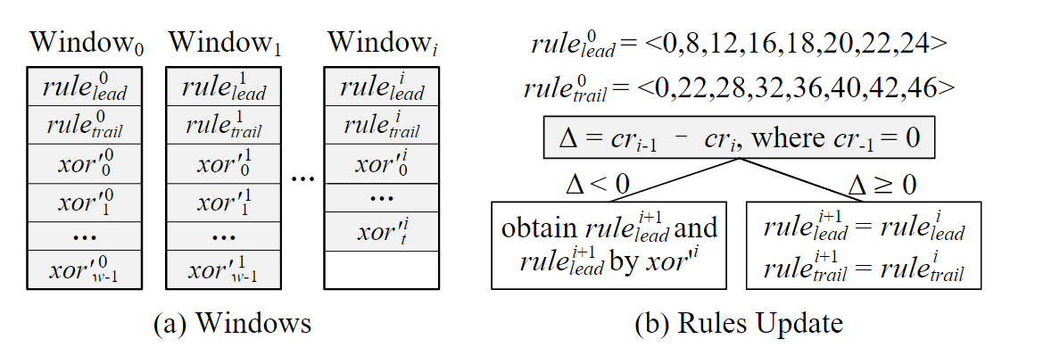
Streaming Scenarios Extension
For both leading zeros and trailing zeros, their distributions are much more similar in the same dataset than in different datasets.

Slide 19
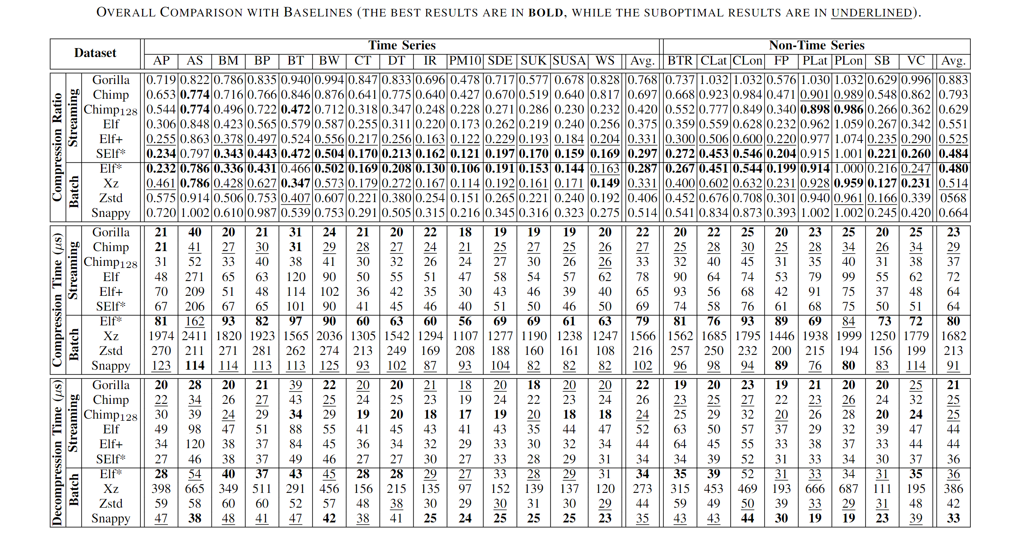
Experiments Overall Comparison with Baselines
Compression Ratio
Compared with Elf+(best streaming competitor): SElf∗ improve 10.27% and 7.8% compression ratio for time and non-time series.
Compared with Xz(best batch competitor):
Elf∗ improve 13.3% and 6.6% compression ratio for time and non-time series.
When considering the compression ratio, compression time and decompression time comprehensively, SElf∗ and Elf∗ can usually achieve remarkable performance.

Slide 20
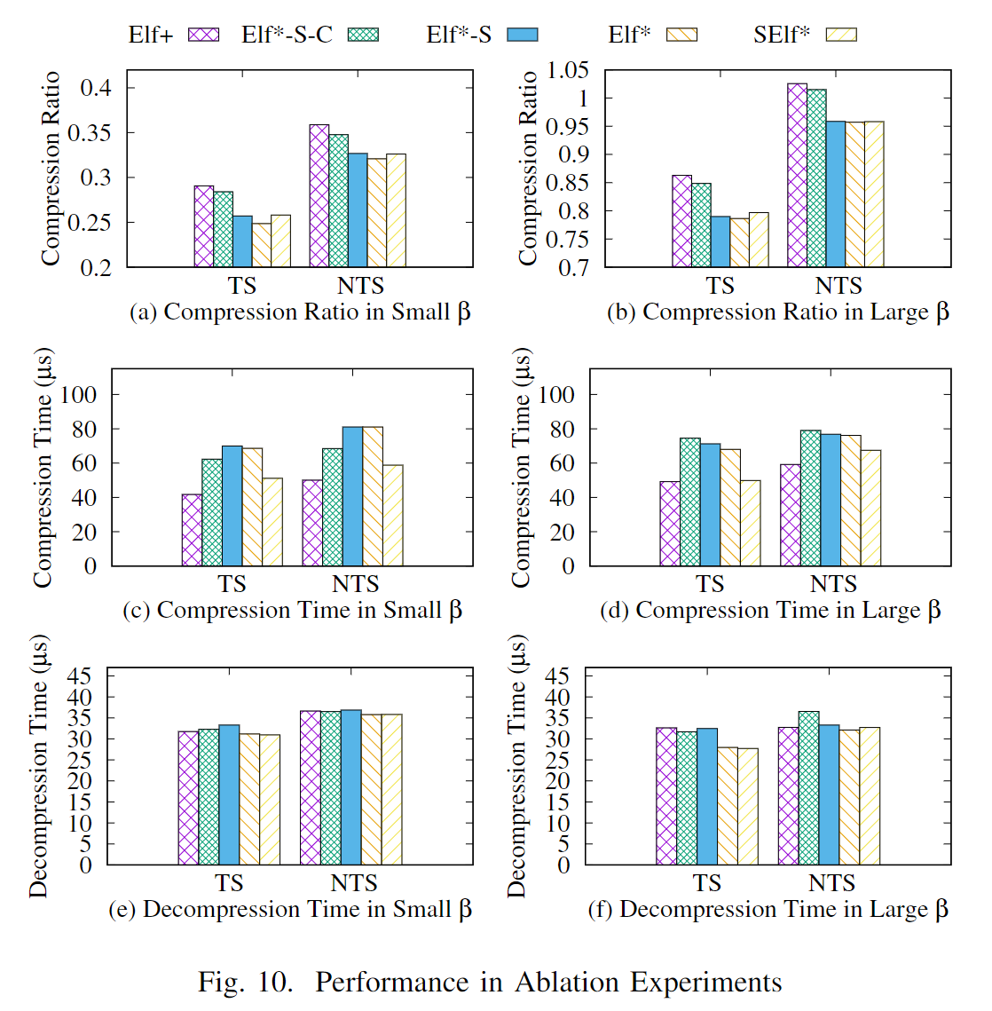
Experiments
Ablation Experiments
1) Compression Ratio
2) Compression Time
3) Decompression Time
Verify the effectiveness of the optimizations for leading zeros, center bits and sharing condition

Slide 21
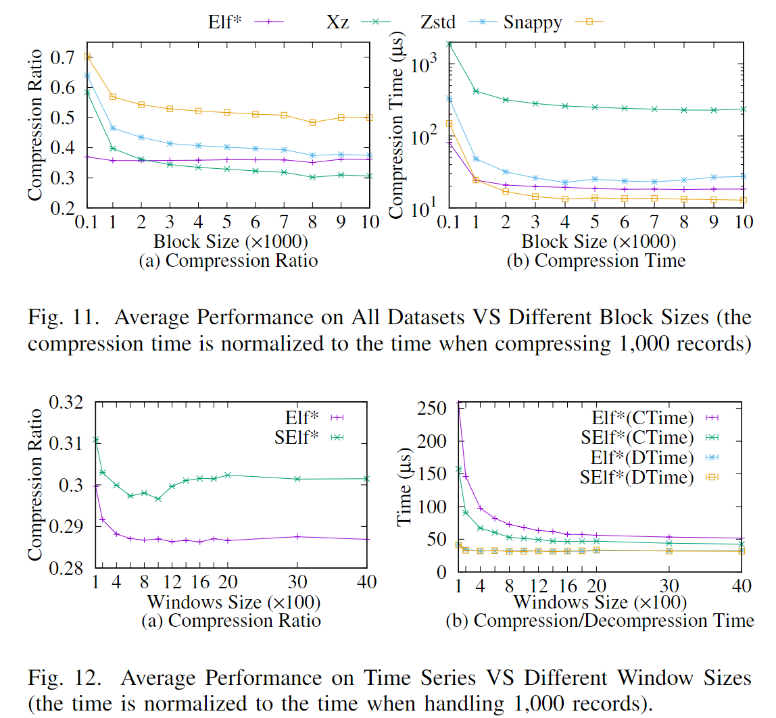
Experiments
When the block size is small, Elf∗ usually performs the best among all compared algorithms. When the block size is large, Elf∗ is still one of the most competitive algorithms.
In our datasets, the window size of 1,000 can ensure a good compression performance for SElf∗.

Slide 22
THANK YOU

